Slide 1
Synthesis of Molybdenum Blue
Amorphous blue material that was first mentioned by C. W. Scheele in 1778 and
today is known as “Molybdenum blue”.
Chemists have applied the “Molybdenum blue test” as a simple, fast, and sensitive method for a qualitative analysis of Molybdenum.
Structures have been resolved by A. Müller and coworkers.
wheel shaped blue polyoxomolybdates with diameters in the range of 2.5 to 6 nm, and they may contain up to 368 molybdenum atoms.
Molybdenum blue is the name given to the blue colouration obtained when
molybdic acid is reduced in acid solution. This reaction is one of the characteristic tests for molybdenum.
applications are-
1. Colorimetric determination of P,As,Si &Ge
2. Colorimetric determination of glucose
3. Colorimetric determination of some drugs containing catechol.

Slide 2
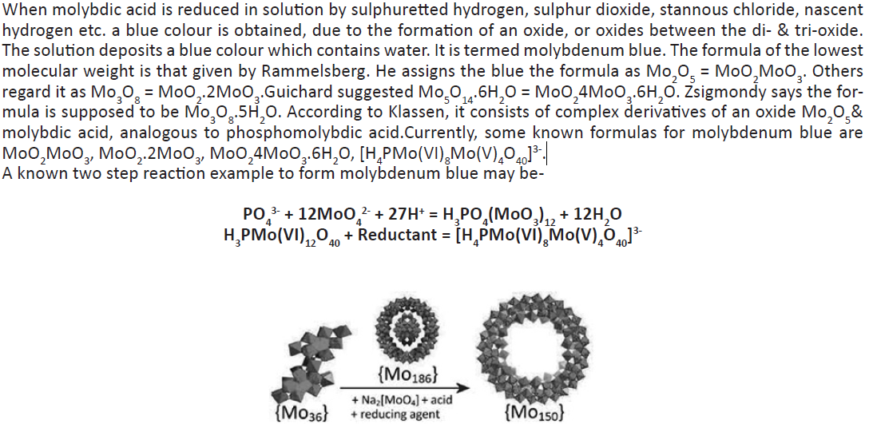

Slide 3
